Slide 1
URL Features
Classification of websites based on URL Features

Slide 2
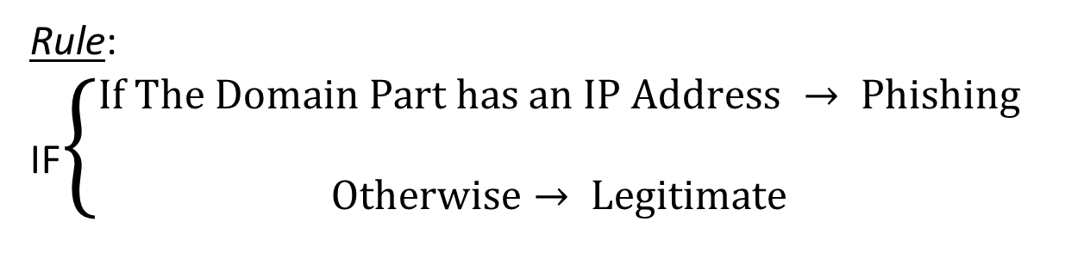
Using the IP Address in URL
Rule: IF$\left\{\begin{aligned}If The Domain Part has an IP Address → Phishing \\ Otherwise→ Legitimate\end{aligned}\right.$
The IP address may even be transformed into hexadecimal code as shown in the following link “http://0x58.0xCC.0xCA.0x62/2/paypal.ca/index.html

Slide 3

Long URL to Hide the Suspicious Part
Rule: IF$\left\{\begin{aligned}URL length<54 → feature=Legitimate \\ URL length≥54 and ≤75 =Suspicious \\ otherwise→ feature=Phishing\end{aligned}\right.$

Slide 4

Domain Registration Length
Based on the fact that a phishing website lives for a short period of time, we believe that trustworthy domains are regularly paid for several years in advance.
Rule:
IF$\left\{\begin{aligned}Domains Expires on≤ 1 years → Phishing \\ Otherwise→ Legitimate\end{aligned}\right.$

Slide 5
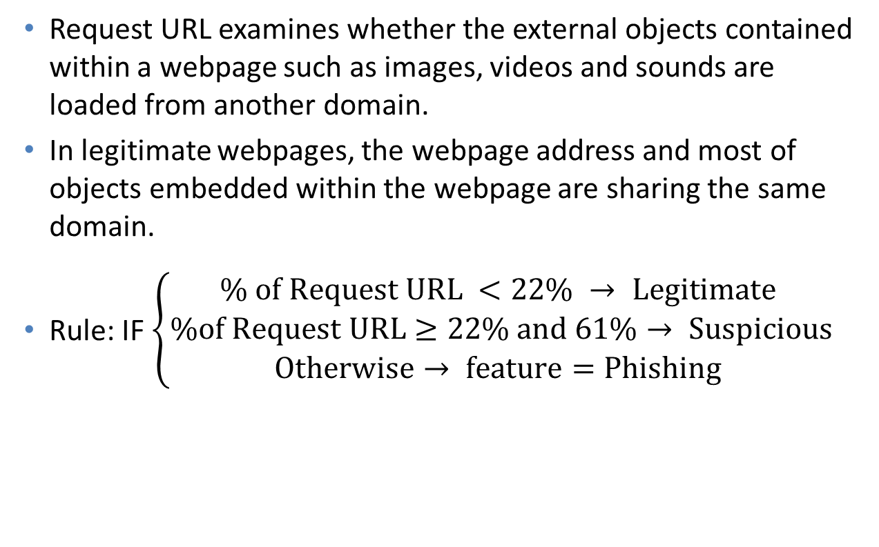
Request URL
Request URL examines whether the external objects contained within a webpage such as images, videos and sounds are loaded from another domain.
In legitimate webpages, the webpage address and most of objects embedded within the webpage are sharing the same domain.
Rule: IF $\left\{\begin{aligned}\% of Request URL <22\% → Legitimate \\ \%of Request URL≥22\% and 61\%→ Suspicious \\ Otherwise→ feature=Phishing \end{aligned}\right.$

Slide 6
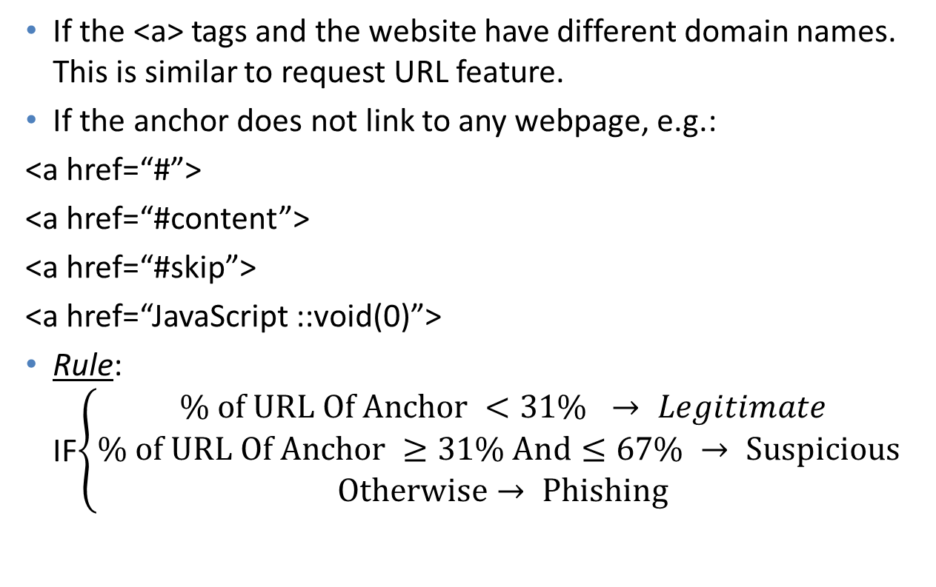
URL of Anchor
If the <a> tags and the website have different domain names. This is similar to request URL feature.
If the anchor does not link to any webpage, e.g.:
<a href=“#”>
<a href=“#content”>
<a href=“#skip”>
<a href=“JavaScript ::void(0)”>
Rule: IF$\left\{\begin{aligned}\% of URL Of Anchor <31\% → Legitimate \\ \% of URL Of Anchor ≥31\% And≤67\% → Suspicious \\ Otherwise→ Phishing\end{aligned}\right.$

Slide 7

Server Form Handler (SFH)
Rule:
IF$\left\{\begin{aligned}SFH is "\text{about}\text{: }\text{blank}\text{"} Or Is Empty → Phishing \\ SFH \text{Refers} \text{To} A Different Domain→ Suspicious \\ Otherwise → Legitimate\end{aligned}\right.$

Slide 8

Using Pop-up Window
Rule:
IF $\left\{\begin{aligned}Popoup Window Contains Text Fields→ Phishing \\ Otherwise → Legitimate\end{aligned}\right.$

Slide 9

Website Traffic
Rule:
IF$\left\{\begin{aligned}Website Rank<100,000 → Legitimate \\ Website Rank>100,000 →Suspicious \\ Otherwise → Phish\end{aligned}\right.$

Slide 10

Age of Domain
This feature can be extracted from WHOIS database (Whois 2005).
Rule:
IF $\left\{\begin{aligned}Age Of Domain≥6 months → Legitimate \\ Otherwise → Phishing\end{aligned}\right.$

